Slide 1

Chapter 6 Security and Reliability of Distributed Software and Systems
Lecture 24
SSL and WCF Security
Text Chapter 6.3
Yinong Chen

Slide 2
Roadmap of Chapter 6
General Security & Reliability Concepts (Text Section 6.1)
IIS Roles and Windows-Based Security Mechanism
Case Study: Windows-Based Security Deployment
Forms-Based Security Creating an independent security system for Web access control and resource authorization
Web.config Support to Forms-Based Security
Access Control with Self-Registration
Secure Socket Layer for Secure HTTP Connection
Data Encryption and Decryption
Reliability and Security in Windows Communication Foundation

Slide 3
The Roles of Cookies
Cookies store user identity in client machine’s hard drive;
Client-related information created in an Web application is stored in client side and in server side;
When the client revisits the Web application, the Web application reads the client side cookies and compares with the server-side information to identify the client.
Cookies are secure. They are of string type and are encrypted:
Open key encryption can be applied: both confidential and digital signature (validation) can be applied.
SSL can be required to encode the credential.

Slide 4
Cookieless Situation to Forms Security
Cookies are used in Session state for the same purpose:
A 120-bit session id is issued and sent to client
The session id allows the client to access session state information
Cookieless is supported for both Session State and Forms Security. The credential will be store in the browser, and URL will be used for transmitting the credential:
Absolute path URL cannot be used;
When relative URL is used, a system method will be used to create the full URL, which can then perform credential encoding and decoding
In this case, the credential will be save while the browser is still running. If closed, the credential is discarded.

Slide 5
Cookie in Forms Section in Web.config (Pattern)
<forms
name = "CookieName"
loginUri = "URL"
defaultUrl="URL"
protection = "All | Encryption | Validation | None"
Timeout = "10"
requireSSL = "true | false"
slidingExpiration="true | false"
path = "/"
enableCrossApplicationRedirects = "true | false"
cookieless = "UseCookies | UseUri | AutoDetect | UserDeviceProfile"
domain = "domain name"
</forms>
Default: Both encryption & validation will be applied to cookies store on client side.
Cookies are signed (digital signature), so that people modify the cookies. Once modified, they will fail validation.
Cookies are encrypted, so that people cannot read the cookies.

Slide 6
Cookie Attributes in <forms> Section in Web.config
Attribute | Description
cookieless | Four different values, also see previous chapter
defaultUrl | Defines the default URL that is used for redirection after authentication.
domain | Specifies an optional domain to set on outgoing forms-authentication cookies. This setting takes precedence over the domain that is used in the httpCookies element.
enableCross AppRedirects | This attribute can be one of the following values. True Specifies that authenticated users can be redirected to URLs in other Web applications. False Specifies that authenticated users cannot be redirected to URLs in other Web applications.
loginUrl | Specifies the URL to which the request is redirected for logon, if no valid authentication cookie is found, the default is login.aspx.
name | Optional attribute. Specifies the HTTP cookie to use for authentication. If multiple applications are running on a single server and each application requires a unique cookie, you must configure the cookie name in each Web.config file for each application.
path | Specifies the path for cookies that are issued by the application.

Slide 7
Cookie Attributes in <forms> Section in Web.config (contd.)
Attribute | Description
protection (four possible values) | All (Default) Use both data validation and encryption to protect the cookie. Encryption: the cookie is encrypted by using open key system 3DES or DES. Cookies used in this manner might be subject to chosen plain-text attacks. Validation: use a digital signature to verify that the contents of an encrypted cookie have not been changed in transit. The cookie is created by concatenating a validation key with the cookie data, computing a message authentication code (MAC), and appending the MAC to the outgoing cookie. None Specifies that both encryption and validation are disabled for sites that are using cookies only for personalization and that have less stringent security requirements.
requireSSL | True Specifies that an SSL connection is required to help protect the user's credentials during transmission. False (Default) Specifies that an SSL connection is not required.
sliding Expiration | True (Default) Sliding expiration is enabled. The authentication cookie is refreshed and the time to expiration is reset on subsequent requests during a single session. False The cookie expires at a set interval from the time the cookie was originally issued.
timeout | Specifies the time in minutes

Slide 8
Build-in Account Management
Access Control with Self-Registration

Slide 9
User Registration & Account Management
So far we have discussed how to authenticate and authorize users if they have already their credentials stored on the server of the application.
What should we do if we want to allow users to register and create their own credentials?
ASP .Net has created standard Web controls to implement such functions.
Let us continue with our Forms Security example…

Slide 10
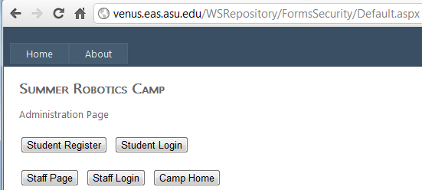

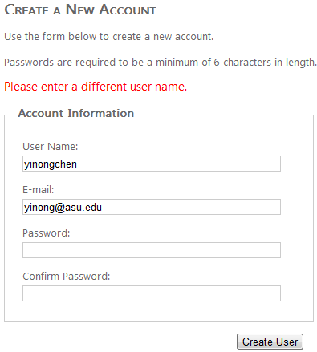
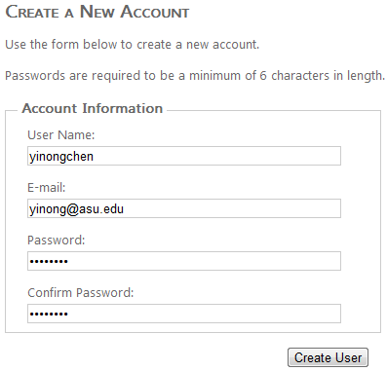
Case Study
http://venus.eas.asu.edu/WSRepository/FormsSecurity/Default.aspx

Slide 11
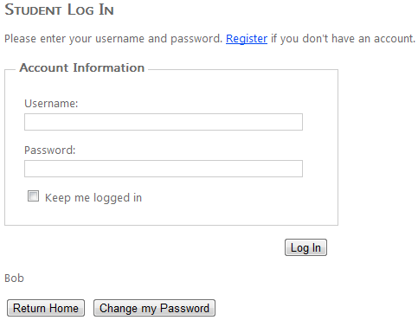
Case Study
http://venus.eas.asu.edu/WSRepository/FormsSecurity/Default.aspx
Show login name if already logged in

Slide 12
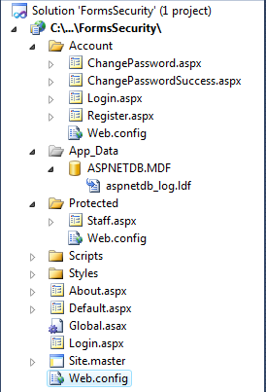
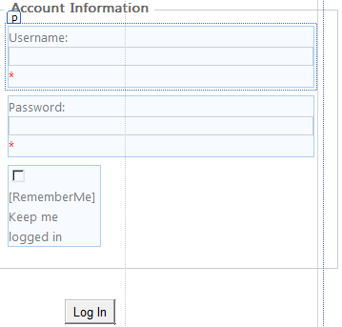
Built-in Support to Account Management

Slide 13
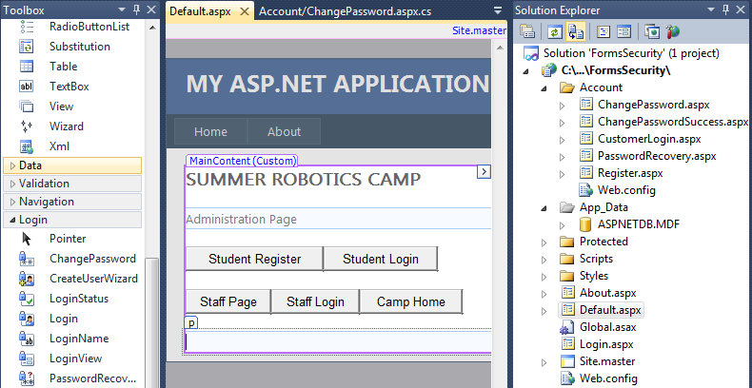
Creating Account Management Pages

Slide 14
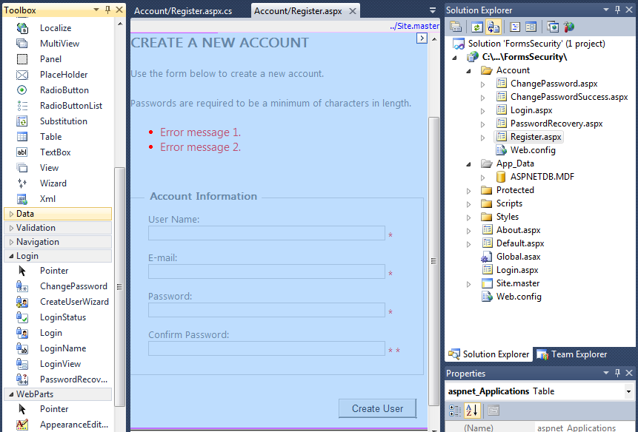
Register Page

Slide 15
The Code Behind the “Register”
using System;
using System.Web.Security; // Contains FormsAuthentication class
public partial class Account_Register : System.Web.UI.Page {
protected void Page_Load(object sender, EventArgs e) {
RegisterUser.ContinueDestinationPageUrl = Request.QueryString["ReturnUrl"];
}
protected void RegisterUser_CreatedUser(object sender, EventArgs e) {
FormsAuthentication.SetAuthCookie(RegisterUser.UserName, false /* createPersistentCookie */);
string continueUrl = RegisterUser.ContinueDestinationPageUrl;
if (String.IsNullOrEmpty(continueUrl)) {
continueUrl = "~/";
}
Response.Redirect(continueUrl);
} }

Slide 16
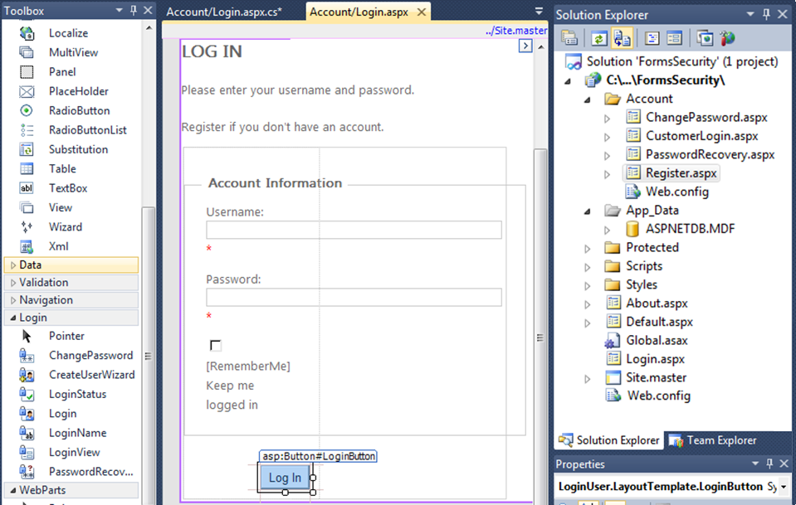
Creating The Customer Login Page
Different

Slide 17
The Code Behind the Built-in “Log in” Page
using System;
using System.Web; // contains HttpUtility class
public partial class Account_Login : System.Web.UI.Page {
protected void Page_Load(object sender, EventArgs e) {
RegisterHyperLink.NavigateUrl = "Register.aspx?ReturnUrl=" + HttpUtility.UrlEncode(Request.QueryString["ReturnUrl"]);
}
protected void LoginButton_Click(object sender, EventArgs e) { }
protected void btnRtnHome_Click(object sender, EventArgs e) {
Response.Redirect("~/Default.aspx");
}
protected void btnChangePwd_Click(object sender, EventArgs e) {
Response.Redirect("ChangePassword.aspx");
}
}

Slide 18
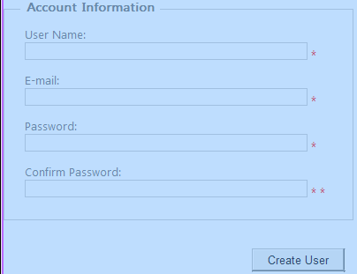
Visual Studio Built-in Support to Security
Database

Slide 19
Customer Accounts in Database
When the Web controls in the Login part of the Toolbox is used, a database storage object will be created automatically and placed in the App_Data folder of the project.
The database object name is: ASPNETDB.MDF
ASP .Net configured this database object to work with SQL Server Express, with the data source default name = SQLEXPRESS, which is the default name.
SQL connection string is stored in machine.config file

Slide 20
Change Database Connection String
When you install SQL Express, do not use the default name SQLEXPRESS, as the name may have been used by the server, causing conflict;
If a different name is used when installing SQL express, or full SQL is used:
Open and edit the <connectionStrings) element:
C:\Windows\Microsoft.NET\Framework\v4.0\Config\machine.config
<connectionStrings>
<add name="LocalSqlServer" connectionString="data source=.\SQLEXPRESS; Integrated Security=SSPI; AttachDBFilename=|DataDirectory|aspnetdb.mdf; User Instance=true" providerName="System.Data.SqlClient"/>
</connectionStrings>

Slide 21
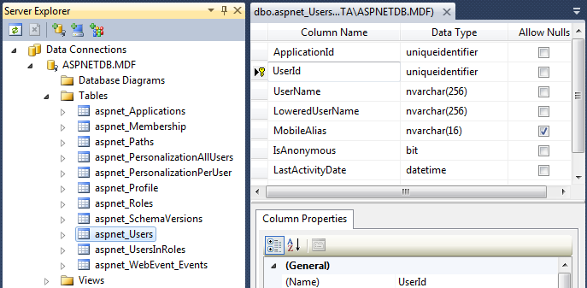
SQL Express Data Object Created
Manipulation of the database will be discussed in the Part 2 of the text Chapter 10: LINQ.

Slide 22
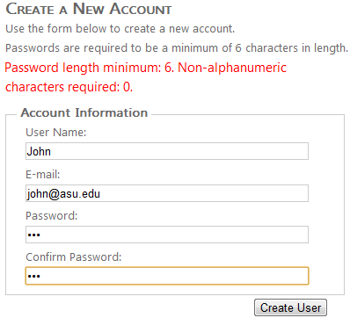
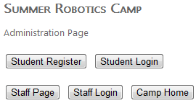
Demonstration
The example with registration page and database:
http://venus.eas.asu.edu/WSRepository/FormsSecurity/

Slide 23

Protecting Data in Communication
SSL -- Secure Socket Layer for Secure HTTP Connection (Binding)

Slide 24
SSL Protocol Stack
The SSL Protocol Stack is composed of two layers.
The first layer is the higher layer, used in the management of SSL exchanges. It consists of
SSL Handshake Protocol,
SSL Change Cipher Spec Protocol,
SSL Alert Protocol, and
HTTP.
The second layer is the lower layer consists of the
SSL Record Protocol,
TCP, and
IP.

Slide 25
SSL Session and Connection States
An SSL session is an connection between a client and server. Multiple sessions are possible between a client and server
An SSL connection is a transport that provides a type of service. Connections are peer-to-peer relationship.

Slide 26
Session State Used in SSL
The session state includes the following elements:
session identifier - A byte sequence chosen by the server to identify an active or resumable session state
peer certificate - X509.v3[X509] certificate of the peer. This element of the state may be null.
compression method - the algorithm used to compress data prior to encryption.

Slide 27
Session State Used in SSL (cont’d)
cipher spec - Specifies the bulk data encryption algorithm (such as DES, etc.) and a MAC (Message Authentication Code) algorithm. It also defines cryptographic attributes such as the hash_size.
master secret - 48-byte secret shared between the client and server.
is resumable - A flag indicating whether the session can be used to initiate new connections.

Slide 28
Connection State
The connection state includes the following elements:
server and client random - Byte sequences that are chosen by the server and client for each connection.
server write MAC secret - The secret used in MAC operations on data written by the server.
client write MAC secret -The secret used in MAC operations on data written by the client.
server write key - The bulk cipher key for data encrypted by the server and decrypted by the client.

Slide 29
Connection State (cont’d)
client write key - The bulk cipher key for data encrypted by the client and decrypted by the server.
initialization vectors - When a block cipher in CBC mode is used, an initialization vector (IV) is maintained for each key.
sequence numbers - Each party maintains separate sequence numbers for transmitted and received messages for each connection. When a party sends or receives a change cipher spec message, the appropriate sequence number is set to zero.

Slide 30
SSL Record Protocol
Application data
Plaintext
Fragmentation
SSLPlaintext block
SSLPlaintext block
Compression
SSLCompressed
Encryption
SSLCompressed
MAC
SSLCompressed
TCP
H
SSLCompressed
TCP package

Slide 31
SSL Record Protocol Steps
Fragmentation: The record layer fragments information blocks into SSLPlaintext records of 2¹⁴ bytes or less.
Compression: All records are compressed using the compression algorithm. The compression algorithm translates an SSLPlaintext structure into an SSLCompressed structure.
Compute a MAC – All records are protected using the encryption and MAC algorithms defined in the current CipherSpec. A shared secret key is used.

Slide 32
SSL Record Protocol Steps (cont’d)
Null or standard stream cipher - Stream ciphers convert SSLCompressed fragment structures to and from stream SSL Ciphertext
CBC block cipher - For block ciphers (such as DES), the encryption and MAC functions convert SSLCompressed fragment structures to and from block SSLCiphertext fragment structures.
Record header

Slide 33
Secure Sockets Layer in Web Application
HTTPS is based on Secure Sockets Layer (SSL)
To apply HTTPS to your Web server,
Request/Purchase the security certificate from a certification authority;
Install the certificate on the server, which consists of an open key and a secret key;
Clients use https connection to access the server. https: SSL over HTTP is the most common application of SSL

Slide 34
Roles of SSL Certificate Authorities
Issue a certificate showing the server uses the up-to-date encryption method;
Make sure that the browsers recognize the certificates
A certificate of a server is similar to the driver’s license of a person.
It certifies that the server uses the up-to-date encryption method and thus has certain level of trustworthiness in providing services (the communication part is secure).
It does not guarantee the quality of services or the security within the server.
Analogy: Driver’s license: the person can drive, but it does not tell the person has good driving habit. It does not tell the person has good credit score. Credit bureau or BBB.

Slide 35
SSL Certificate Offering Organizations
Certificate is offered by independent organizations, such as
GeoTrust: http://www.geotrust.con
GlobalSign: http://www.globalsign.com
Thawte: http://www.thawte.com
VeriSign: http://www.verisign.com
There are some organizations offer free or low cost SSL certificates
StartCom: https://cert.startcom.org/ (http://en.wikipedia.org/wiki/StartCom)
Cacert: http://www.cacert.org/ (http://en.wikipedia.org/wiki/CAcert.org)

Slide 36
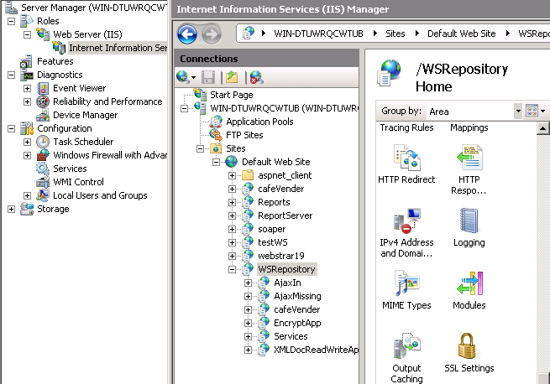
Generating Certificate Signing Request (CSR) -1
Access the IIS Microsoft Management Console (MMC): right-click My Computer and click Manage.
This opens the Computer Management Console.
Locate IIS and expand the IIS console.
Source:
http://support.microsoft.com/kb/298805

Slide 37
Generating Certificate Signing Request (CSR) - 2
Select the Default Web site in IIS on which you want to install a server certificate. Right-click the site and click Properties.
Click the Directory Security tab. In the Secure Communications section, click Server Certificate. This starts the Web Server Certificate Wizard. Click Next.
Select Create a New Certificate and click Next.
Select Prepare the request now, but send it later and click Next.
In the Name field, enter a name that you can remember. It will default to the name of the Web site for which you are generating the CSR.
When you generate the CSR, you need to specify a bit length. The bit length of the encryption key determines the strength of the encrypted certificate. Most third-party CAs prefer a minimum of 1024 bits.

Slide 38
Certificate for Testing Purpose
Before you purchase the SSL certificate, you can generate a certificate of your own for testing purpose;
After you have completed your development and before you release to customer, you must purchase the certificate from authorized thirty party;
There are many encryption methods. Some are not secure. Certification makes sure you use a secure one.
It is unethical to use https without being certified: When users see https, they assume that you have been certified, and they use your website assuming that their confidential information will not be compromised in the communication.

Slide 39
Create Your own Certificate for your Server
For testing purpose, you could create a certificate for your machine, run the Setup.bat that is included in each of the samples that use secure communication with IIS.
Ensure that the path includes the folder that contains Makecert.exe before you run this batch file. The command used to create the certificate in Setup.bat is:
makecert -sr LocalMachine -ss My -n CN=ServiceModelSamples-HTTPS-Server -sky exchange -sk ServiceModelSamples-HTTPS-Key
Source: http://msdn.microsoft.com/en-us/library/ms751408(VS.85).aspx

Slide 40
Installing Certificates in Windows Server
Open the Internet Information Services Manager.
Right-click the default Web site and select Properties.
Select the Directory Security tab.
Click the Server Certificate button. The Web Server Certificate Wizard starts.
Complete the wizard. Select the option to assign a certificate. Select the ServiceModelSamples-HTTPS-Server certificate from the list of certificates that are displayed.

Slide 41
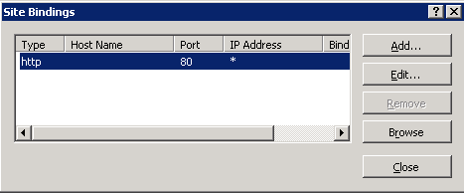
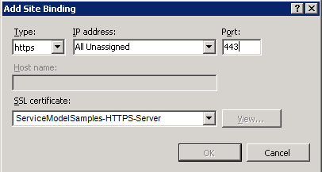
Installing Certificates in Windows Server (contd.)
Open the Internet Information Services Manager.
Right-click the Default Web Site and select Add… or Edit…
Select HTTPS from the Type drop-down list.
Select the certificate from the SSL certificate drop-down list and click OK

Slide 42
Override Certificate Validation Callback
WCF check whether a certificate has been signed by a third-party authority.
In the test phase using unsigned certificate, you can ignore the warning before every WCF call:
warning
//Overriding the certificate validation callback
System.Net.ServicePointManager.ServerCertificateValidationCallback += (se, cert, chain, sslerror) =>
{
return true;
};
Overriding certificate validation callback is for testing purpose only. It is unethical and can be a crime to let user believe that your sever has SSL certificate, but it does not.

Slide 43
Testing Your HTTPS Connection
Test access to the service in a browser by using the HTTPS address https://localhost/secureConnectionServices/service1.svc
Indicating the message from browser to server will be encrypted

Slide 44
Testing Client’s Connection
Protected void Page_Load(Object sender, EventArgs e)
{
if (request.IsSecureConnection)
{
lblStatus.Test = “This page is connected through SSL”;
}
else
{
lblStatus.Test = “Please use https connection”;
}
}

